Slide 1

TRIP MATE
Subject : Robotic Business Process Automation
Course Code : COM-212
Faculty In-Charge : Asst Prof. Ms. Vani Malgar
Name : GOKUL KANGOTRA Roll No. : 2022a1r007 Branch : CSE (A2) Group : G3 Session :2022-26
Name : Anshul Bhau Roll No. : 2022a1r010 Branch :CSE(A2) Group :G3 Session: 2022-26

Slide 2
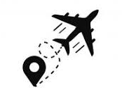
INTRODUCTION
The project is to streamline the flight search and booking process, making it easier and less time-consuming for users. With Travel Buddy, you can say goodbye to the hassle of manually searching for flights and comparing prices. Our advanced algorithms do it all for you, providing you with the best options at the click of a button

Slide 3
Problem statement
"Time-consuming process of retrieving, organizing, and sharing flight details from MakeMyTrip, which can be automated to improve efficiency and accuracy."

Slide 4
Methodology
User Interaction
Web scraping
Data manipulation
Excel file generation
Email integration

Slide 5
FLOWCHART
TAKES INPUT
OPEN BROWSER
TYPE THE INPUT
SEARCH THE FLIGHTS
SCRAP THE FLIGHTS DATA
Fill excel sheet
Read the data
Send mail to the user

Slide 6





Workflow

Slide 7

Why Tripmate?
Trip Mate revolutionizes travel planning with automated extraction of MakeMyTrip flight details, organizing them into Excel, and seamless email sharing. It saves time, ensures accuracy, and enhances convenience for effortless travel arranement.

Slide 8
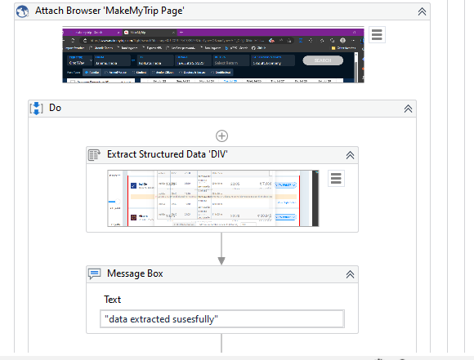
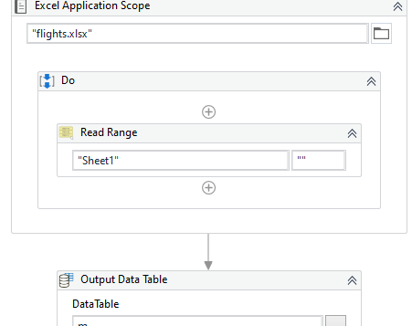
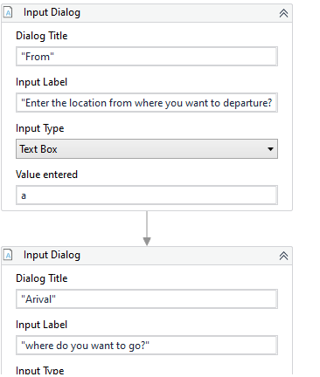
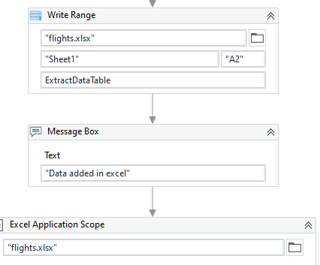
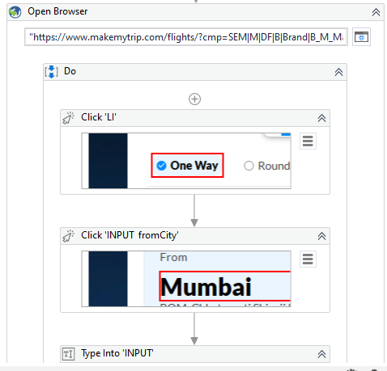
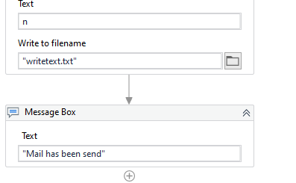
Screenshots

Slide 9
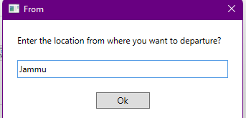

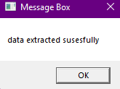
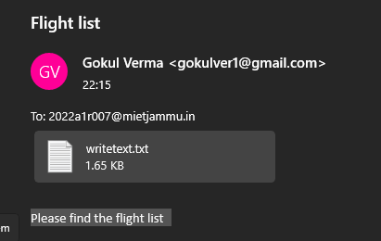
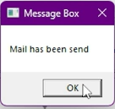
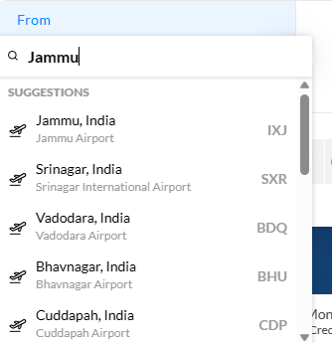
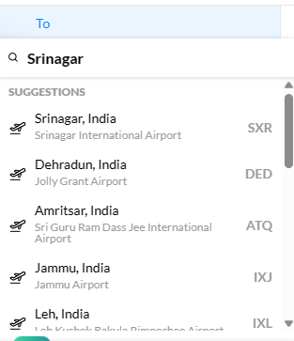
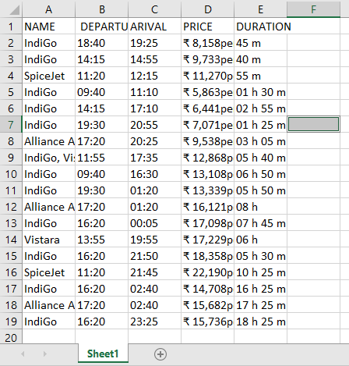
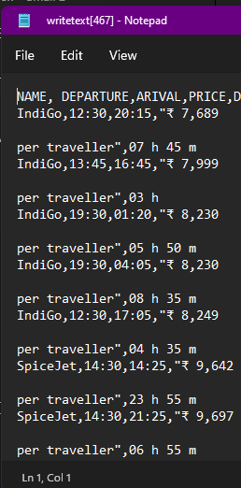
RESULT

Slide 10
Thank You

